Slide 1
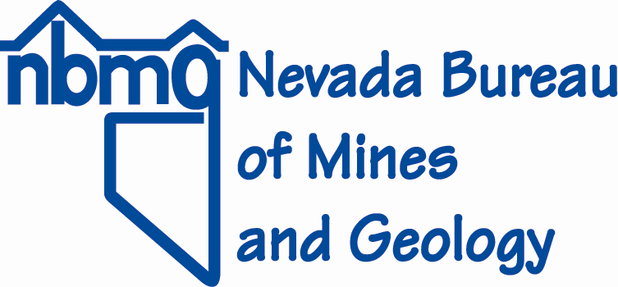
Overview of the Activities of the Nevada Bureau of Mines and Geology as they pertain to Mineral Exploration and Mining
John Muntean
Economic Geologist / Director of CREG
Nevada Bureau of Mines and Geology
University of Nevada Reno
Presentation to the
NEVADA MINING OVERSIGHT & ACCOUNTABILITY COMMISSION
Carson City Nevada
October 31, 2013
Notes:
Thank you.
I will just go directly to the first slide

Slide 2
Nevada Bureau of Mines and Geology Supporting the Mining and Mineral Exploration Industry and Helping Government Agencies and Legislators Make Informed Decisions on Nevada’s Lands
Providing Information
Maps, Databases, Samples, Reports, Mineral Assessments
Reporting on the Mining Industry
Annual Mineral Industry Reports
Exploration Surveys
Geologic Mapping
Research on how mineral deposits form and how to explore for them
Training Graduate Students

Slide 3
Non-Fuel Mineral Production in Nevada Another Record Year in 2012!
$11.2B in 2012
Gold accounted for 85% of that value
5.615 Moz produced in 2012, slight increase over 2011
Nevada was third largest gold producer in the world after China and Australia
USGS reported Nevada gold production to be 2.6Moz for the first 6 months of 2013

Slide 4
Several New Gold Mines in 2012-2013
Emigrant Spring – Newmont
Gold Hill – Round Mountain JV
Lucerne – Comstock
Sterling – Imperial Metals
Pinson – Atna Resources
Starvation Canyon – Veris Gold
Borealis – Gryphon Gold
Mineral Ridge – Scorpio Gold
Many of these are small deposits operated by junior companies

Slide 5
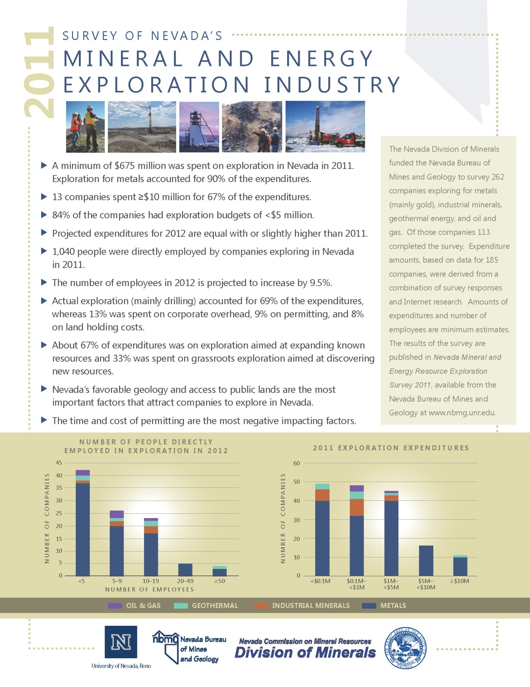
Nevada Mineral and Energy Resource Exploration Survey 2011
Minimum of $675M spent on exploration
Metals, mainly gold, accounted for 90% of expenditures
1,040 people directly employed in exploration
Flier distributed to 2013 Legislature, info was used in testimonies
Notes:
Thank you.
I will just go directly to the first slide

Slide 6
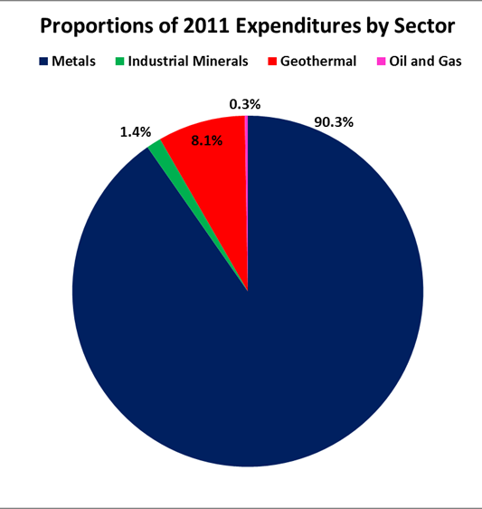
2011 Exploration Expenditures: Mostly on Metals
≥$609M spent by 128 companies
$219M was spent by two companies
>90% of remainder was spent by junior companies
Notes:
Exploration Spending remained high in 2011 with at least $609M spent.
This is based on an exploration survey that the Nevada Bureau of Mines did for the Nevada Division of Minerals and the Commission on Mineral Resources.
Based on expenditure data we collected from 185 companies only 13 spent more than $10M, but those 13 accounted for the 2/3 of the expenditure.
However, companies that spent $10M or less accounted for 65% of grassroots exploration, confirming what we suspected that juniors are doing the majority of grassroots exploration.
We hope to release the report summarizing this survey by the end of the month.

Slide 7
Top Mineral Development Projects
Mount Hope (Mo) – Nevada Moly
Pumpkin Hollow (Cu) – Nevada Copper, 2014-2015
Long Canyon (Au) – Newmont, 2015
Goldrush (Au) – Barrick
South Arturo (Au) – Barrick
Pan (Au) – Midway Gold, 2014
Gold Rock (Au) – Midway Gold, 2015
Spring Valley (Au) – Barrick/Midway
Fire Creek (Au) – Klondex

Slide 8
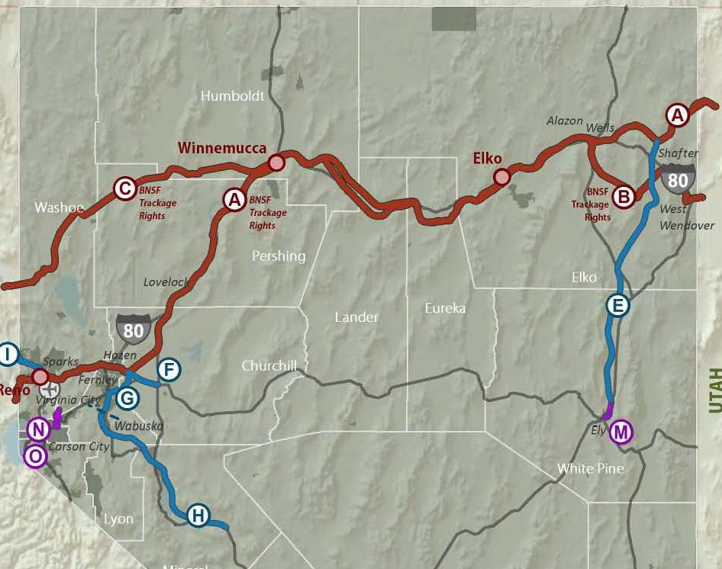
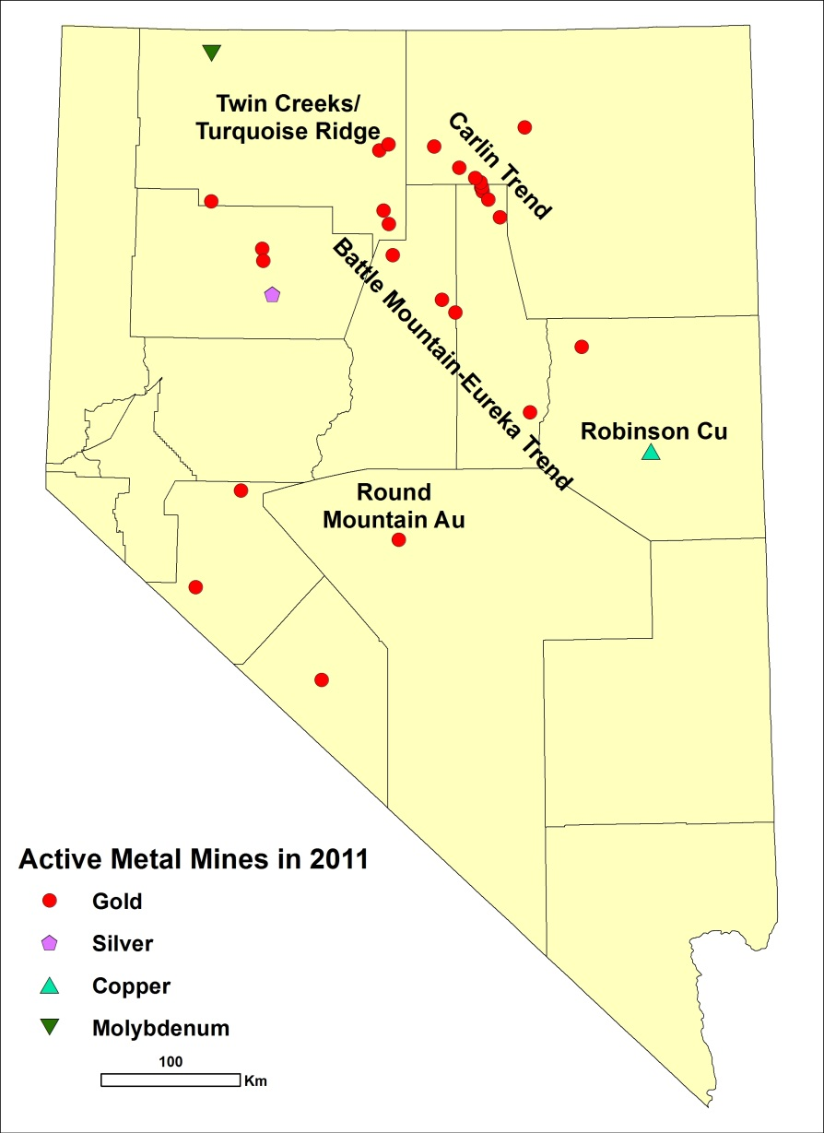
Top Projects
Long Canyon
South Arturo
Spring
Valley
Goldrush
Fire Creek
Mt. Hope
Pan
Pumpkin Hollow (Cu Concentrates)
Gold Rock

Slide 9
Exploration Spending Appears to be Slowing Down
Gold price plummeted in 2013 – down from $1684/oz to low of $1223/oz in July, now at ~$1350/oz
218,407 mining claims registered (old and new) in fiscal 2013, 2.8% decrease from 2012
At least 106 projects drilled in 2012 (94 for gold), compared to 130 in 2011
Exploration spending by junior companies has been grinding to a halt in 2013
Large companies have had layoffs, mainly contract geos, but also staff geos

Slide 10
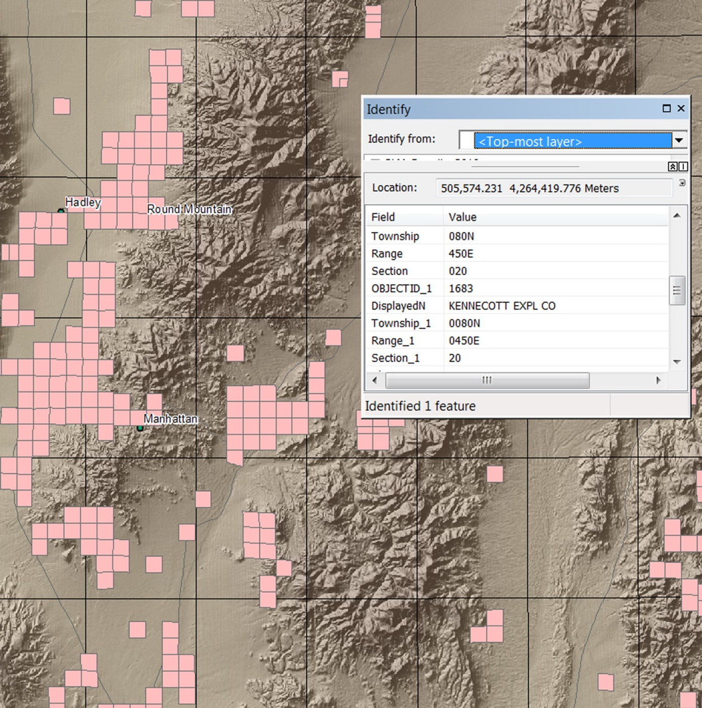
NBMG Providing Data to Make Informed Decisions
Mineral Assessments
Sage Grouse
Notes:
Thank you.
I will just go directly to the first slide

Slide 11
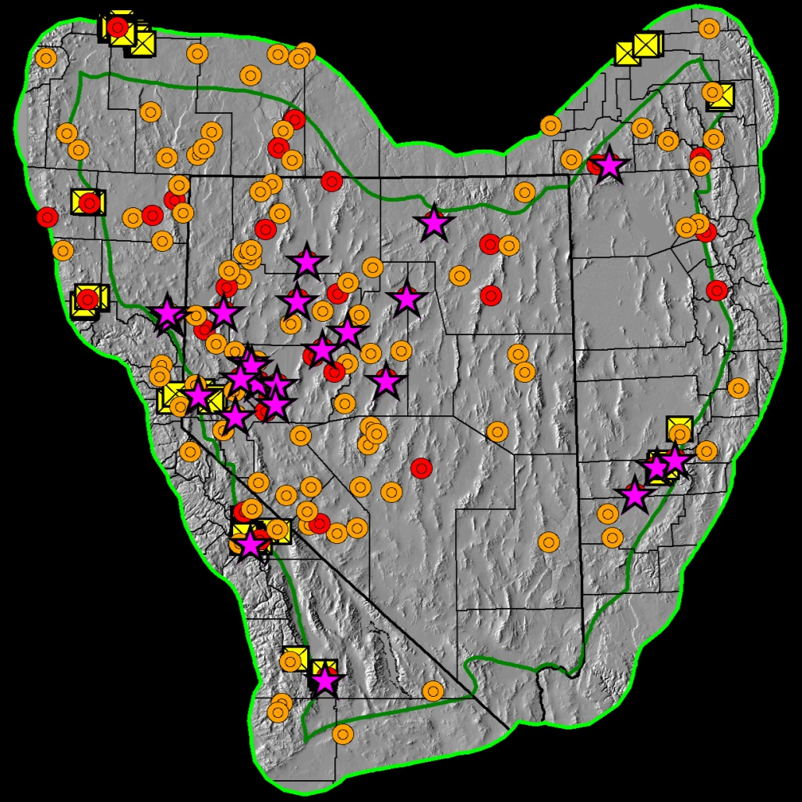
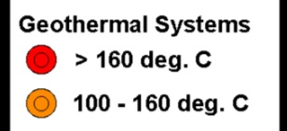
Geothermal Production
$162,466,512 (2012 gross proceeds, ~7% increase over 2011)
Nearly 500 MW capacity
Much greater potential
Most resources blind or hidden
Great Basin Geothermal Systems:
Distribution of Known Systems

Slide 12
Petroleum – Noble Energy

